Slide 1

SwarmNet 3D Implementation

Slide 2
Recall the Problem
Designing multi-robot systems is difficult and they’re hard to predict
SwarmNet

Slide 3
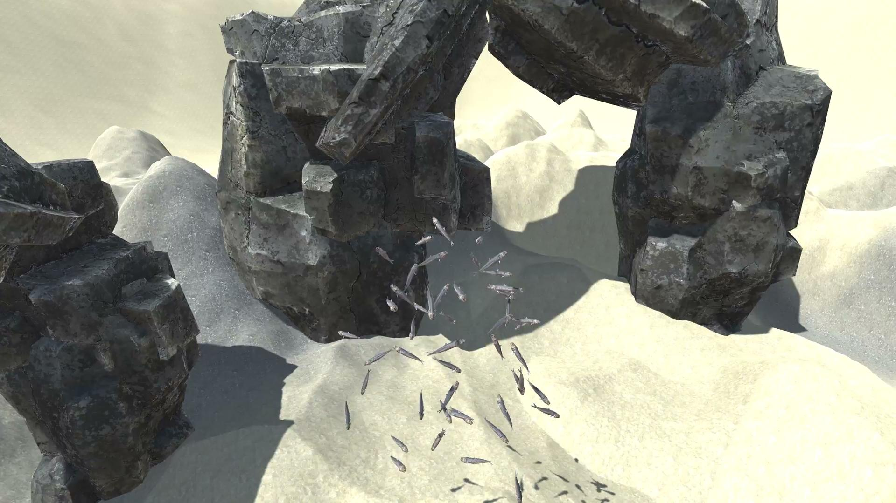
Swarm Net Control

Slide 4
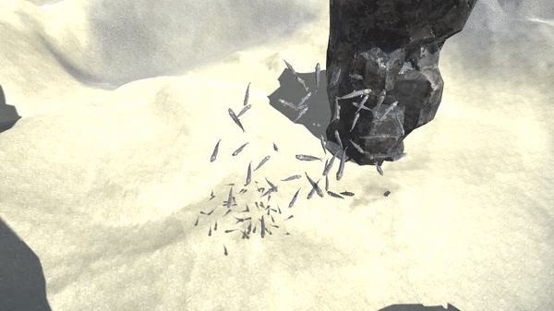
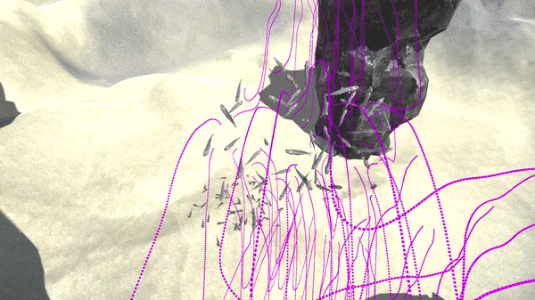






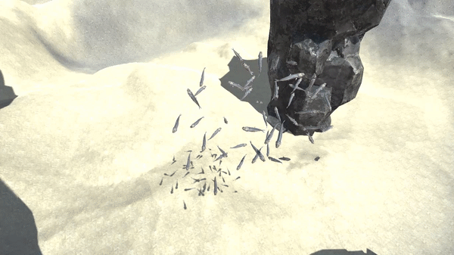


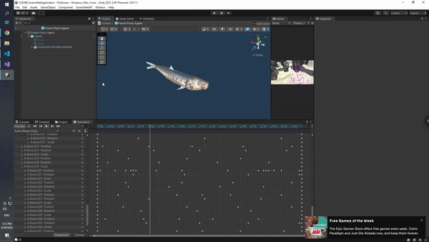





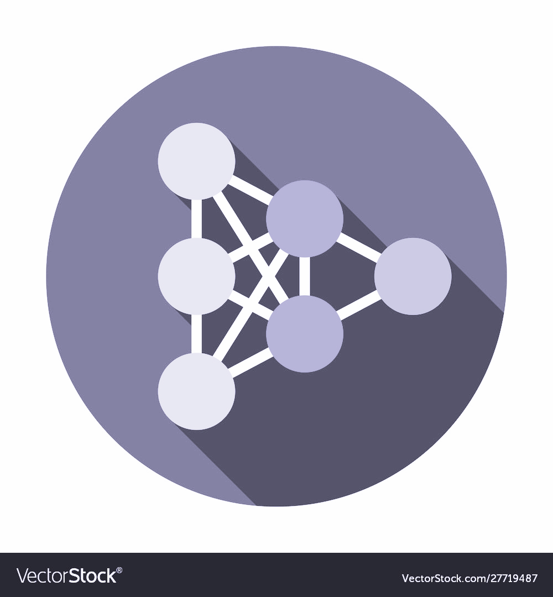
Overview
Training
Multiple runs of simulation
~3,000 time-steps each
50 agents
Random spawns & obstacle positions
20, 30, and 40 step curriculum learning
Training was very slow
Loops → Tensor operations
Move
Together
Stay Close
Original Swarm Behaviors
Desired
Behavior
Timestpes
Avoid Obstacles
Remain Near
Spawn
State
Agents
Obs.
SwarmNet Model
Game Update Loop
Input
Variables
Move Fish
Next Agent
Timestep
1-D Convolutions
Dataset 1
Dataset 2
Mean Square
Error
Control
Condensed States
Graph Convolution
Record Movements
Agents
Vertex Representation…
Edge Prop...
Obstacles
Conv.
History
Show Path
Update
Interval
MLP Decoder
Update Control?
Output
Yes
No

Slide 5
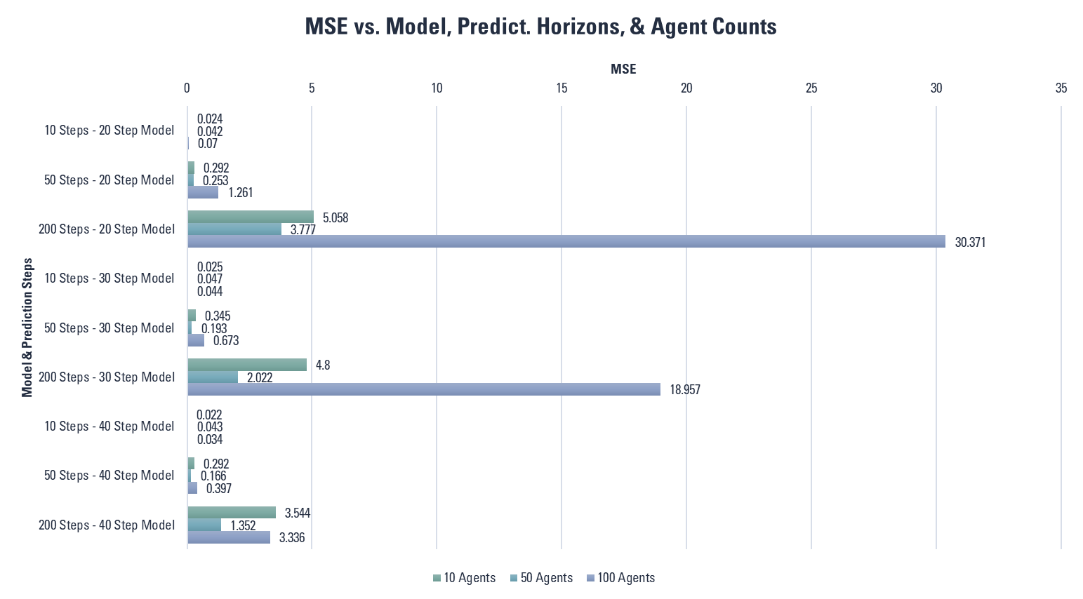
Testing - MSE Loss
Relatively low MSE up to 200 step predictions
Good scaling down from number of agents in training data
Difficulty with more agents!

Slide 6
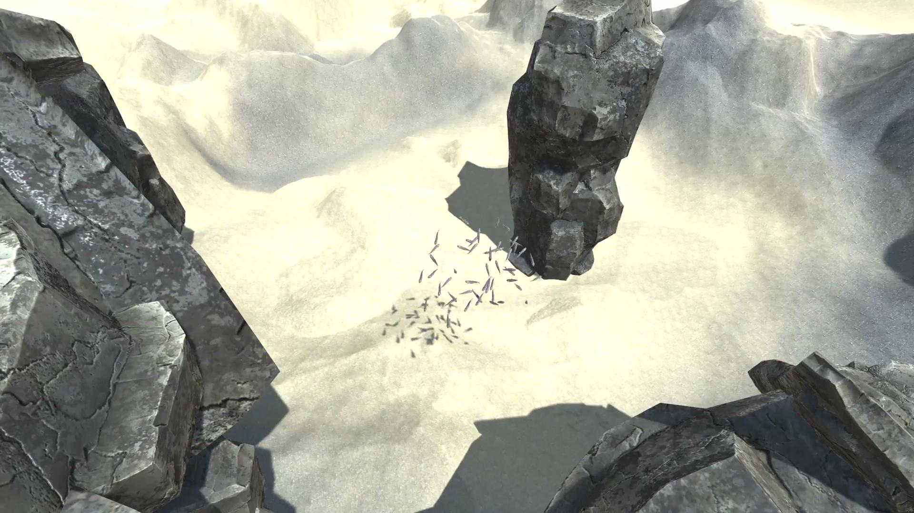
Testing - Control
Agents follow each other, remain mostly cohese
Runtime is close real time (>50%)

Slide 7
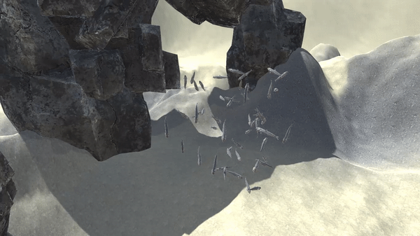
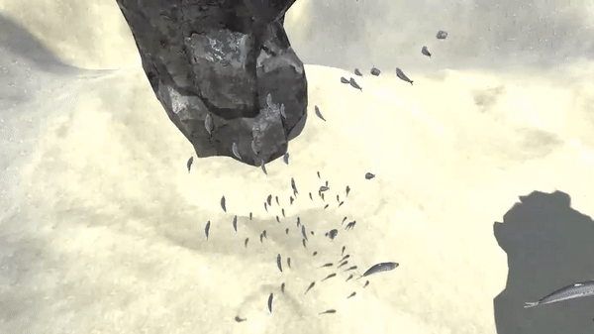
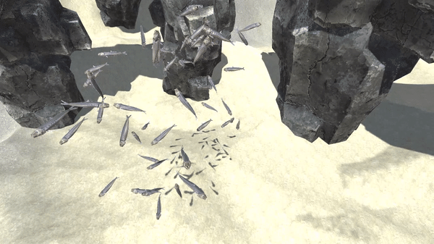
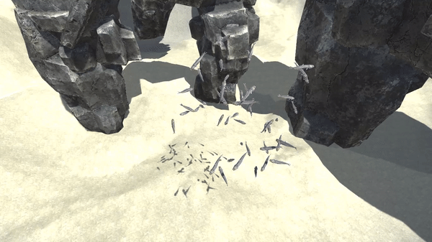
Caveat…
Obstacle avoidance is below par.
Bad generalization for terrain features
Specific situations can lead to chaos
Error propagation

Slide 8



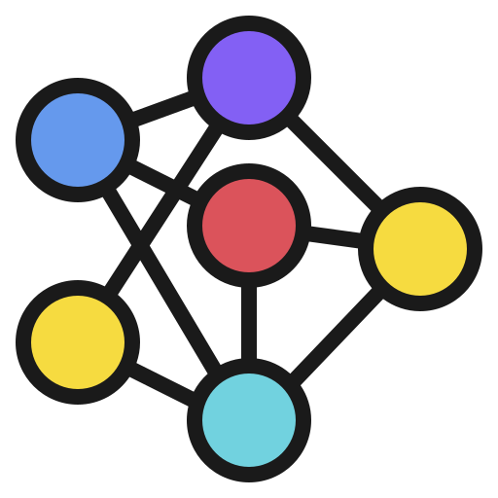


Concluding Remarks
Extendable to 3D
Validation of real time control
More Data and Training
Cloning more complex behaviors?
There is a lot left to explore

